Slide 1

NATIONAL INSTITUTE OF TECHNOLOGY PATNA
DEPARTMENT OF COMPUTER SCIENCE AND ENGINEERING
INARMJHA
SMART OS THAT RUNS A SMART HOME
K.N.S.N.GURU CHARAN
1406102
N.S.KRISHNA
1406036
B.S.REDDY
1406001
M.K.KUMAR
1406015
UNDER THE GUIDANCE OF
Dr. M.T.U HAIDER
DEPARTMENT OF COMPUTER SCIENCE AND ENGINEERING

Slide 2
Contents
1 What is INARMJHA?
2 INARMJHA Flow Diagram
3 Operating system module
4 Face recognition module
5 Communication module
6 Devices module
7 Future work

Slide 3
INTRODUCTION
ARTIFICIAL INTELLIGENCE HAS CHANGED UNDERSTANDING OF THE HUMAN THINKING AND MODELLING OF THE HUMAN BRAIN
OPERATING SYSTEM ARE A SET OF PROGRAMS THAT MANAGES THE RESOURCES .THE RESOURCES CAN BE OF ANYTHING LIKE COMPUTER RESOURCES AND MAY BE ELECTRONIC DEVICES

Slide 4



INARMJHA
“JHA” IN ARM
“JHA” is an operating system that controls your smart home .It can do the following things for you:-
Provides security by using a door camera and face recognition technology
Controls all the devices of your home through the local area network
Can talk to you through the app and understand your command in natural language
JHA IS POWERED BY MACHINE LEARNING

Slide 5
These are the various modules that helps INARMJHA to give its capabilities
Modules (Sub Problems) :
Operating system module
Face recognition module
Communication module
Natural language module
Devices module

Slide 6
Door Camera
App
Images
Notification of the image
Messages
Face Recognition Module
Devices of recommendation
Natural Language Module
Recommender Module
Chatter bot
Operating System
Hexa codes
Devices Module

Slide 7
INARMJHA OPERATING SYSTEM

Slide 8
These are components used in building an Operating System:
Kernel - Arch Linux
Desktop Environment – GNOME

Slide 9
Kernel of the operating System :
Arch Linux Kernel version : 4.9.6-1-ARCH
Desktop Environment:
GNOME is used. GNOME is a desktop environment that aims to be simple and easy to use.
Version : GNOME Shell 3.22.2
The GTK+ theme used is “vertex-dark”
The icon theme used is “ Numix –circle-light ”.All these are retrieved from AUR and installed using “pacman”

Slide 10
Additional Packages Required :
These are obtained from Arch User Repository.
The packages are accessible through “pacman”
package-name Description
1. firefox for creating a safer, faster and stable
browser
2. numix-icon-theme-git icon theme

Slide 11
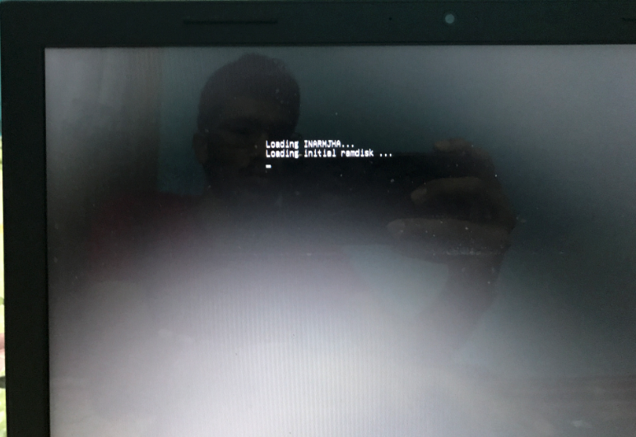
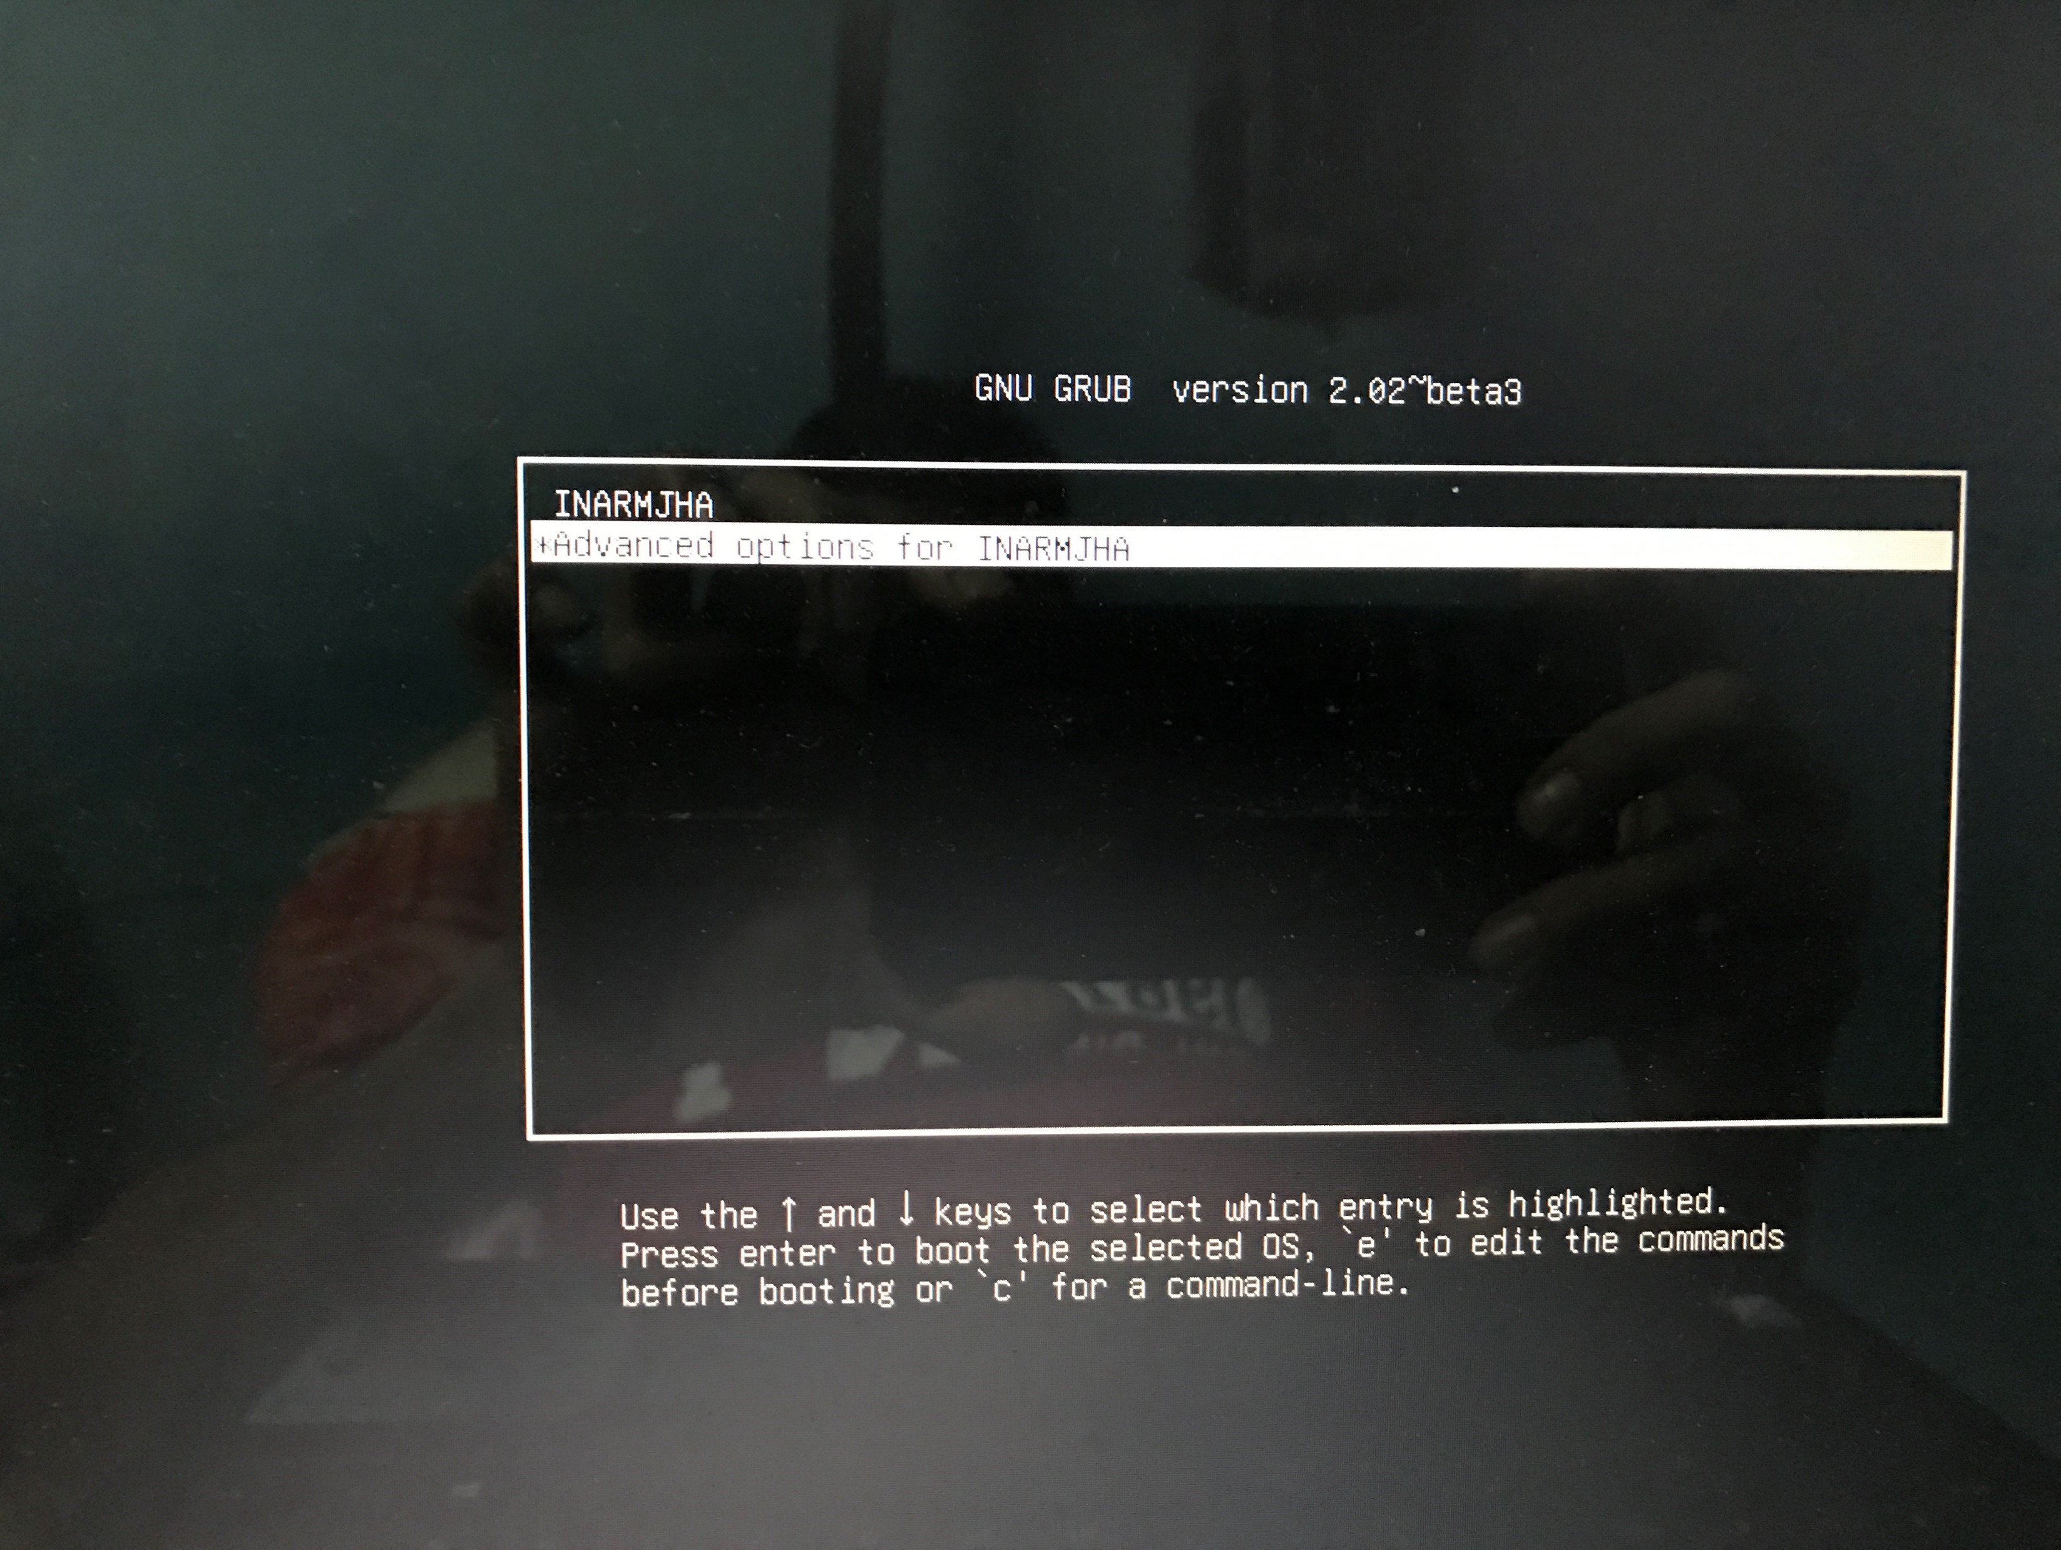
BOOT TIME
BOOT TIME

Slide 12
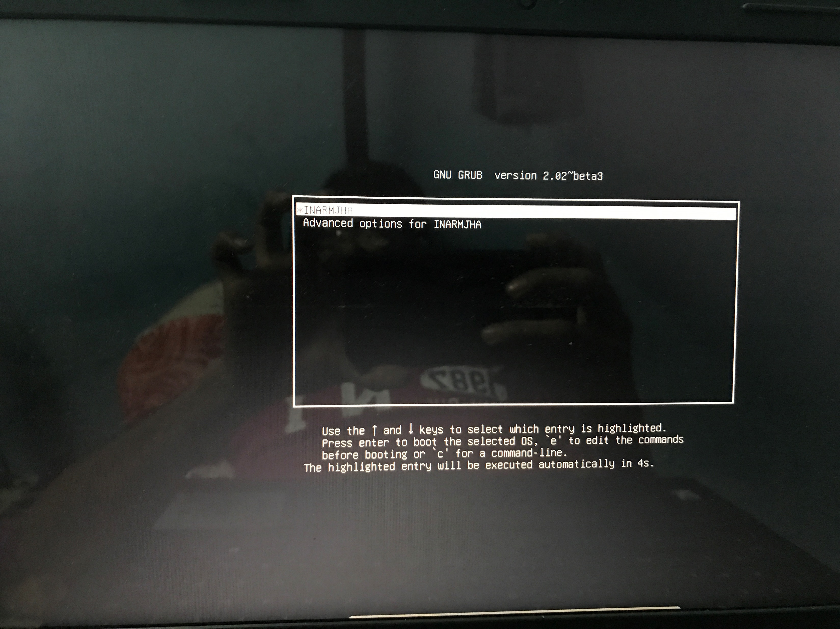
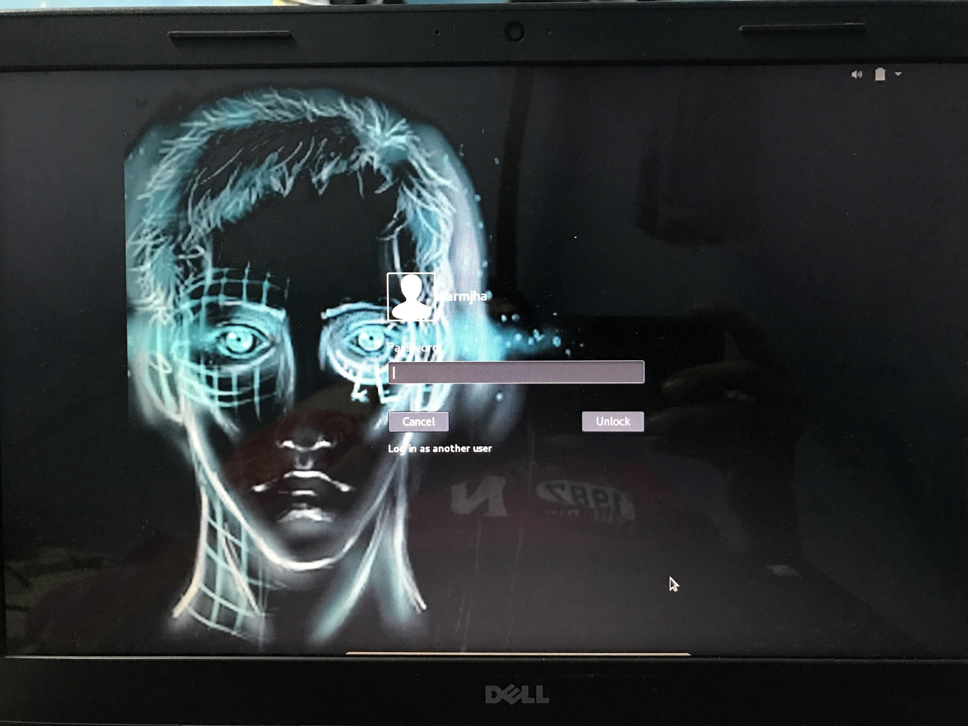
BOOT TIME
LOGIN TIME

Slide 13
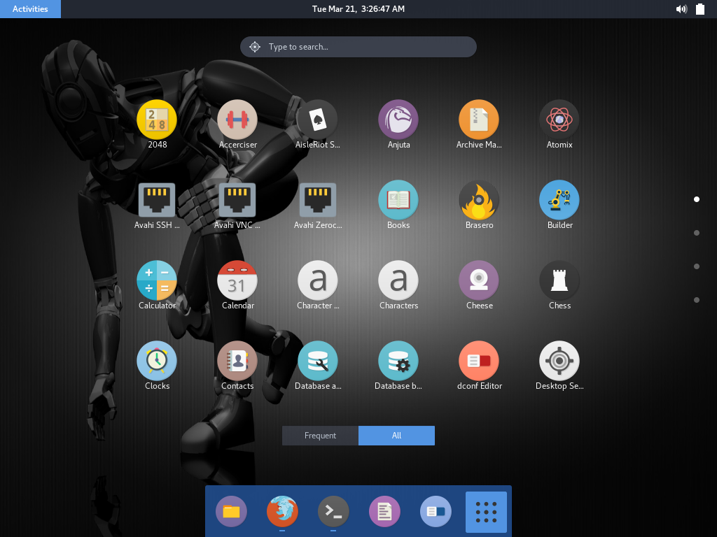
Apps in the operating System

Slide 14
AUTORUN OF BACKGROUND PROCESSES:
AUTOSTARTING :
DAEMONS: The program that runs as back-ground process.
In this OS we run,
Chatter.py, Server.py, Facerecognition.py as background processes.
The background services are written and kept in /lib/systemd/system.
The programs added to these files , they auto start at booting time.

Slide 15
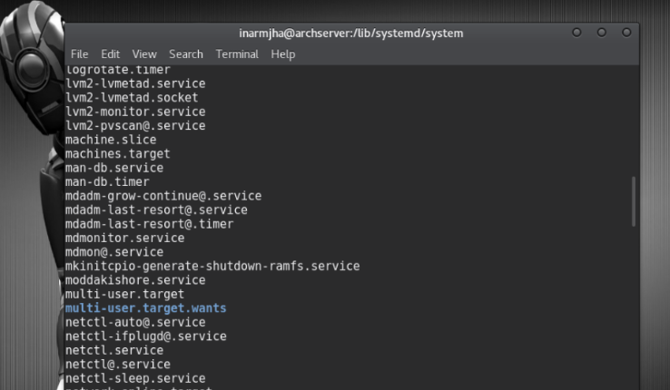
Present path is /lib/systemd/system.
The services that run at boot time or kernel modules are in this directory
Autorun scripts are kept in this systemd/system directory

Slide 16
Face Recognition Module
Face Detection
Face recognition

Slide 17
FACE RECOGNITON
A face recognition system is a computer application capable of identifying or verifying a person from a digital image or a video frame from a video source
One of the ways to do this is by computing selected facial features from the image and a face database
It is typically used in security systems and can be compared to other biometrics such as fingerprint. Recently , it has also become popular as a commercial identification and marketing tool.

Slide 18
STEPS IN FACE RECOGNITION SYSTEM
Face detection from a image
Face identification by comparing the features in the image database

Slide 19
Data Flow Diagram of the Face Recognition Module
Door Camera
Image
Face Detection
Images
No
Face Detected
Cropped images of Faces
Recognition using LBP Classifier
Send Notification to the app along with the image

Slide 20
OPENCV
OpenCV is the most popular library for computer vision
OpenCV uses machine learning algorithms to search for faces within a picture. For something as complicated as a face, there isn’t one simple test that will tell you if it found a face or not. Instead, there are thousands of small patterns/features that must be matched. The algorithms break the task of identifying the face into thousands of smaller, bite-sized tasks, each of which is easy to solve. These tasks are also called classifiers.

Slide 21
Haar feature-based cascade classifiers
Object Detection using Haar feature-based cascade classifiers is an effective object detection method proposed by Paul Viola and Michael Jones in their paper, "Rapid Object Detection using a Boosted Cascade of Simple Features" in 2001, popularly known as a Viola – Jones algorithm
It is a machine learning based approach where a cascade function is trained from a lot of positive and negative images. It is then used to detect faces in other images.

Slide 22
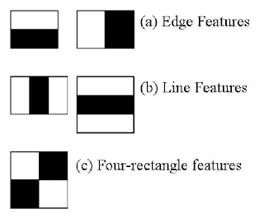
Haar Features
The algorithm is as follows:-
the algorithm needs a lot of positive images (images of faces) and negative images (images without faces) to train the classifier.
Then we need to extract features from it.
For this, haar features shown in below image are used.
Each feature is a single value obtained by subtracting sum of pixels under white rectangle from sum of pixels under black rectangle

Slide 23
Boosting
Boosting is a machine learning ensemble . a family of machine learning algorithms which convert weak learners to strong ones. Boosting is based on the question “ Can a set of weak learners create a single strong learner?”
A weak learner is defined to be a classifier which is only slightly correlated with the true classification (it can label examples better than random guessing).
In contrast, a strong learner is a classifier that is arbitrarily well-correlated with the true classification.

Slide 24
But there the problem is , Even a 24x24 window results over 160000 features.
how do we select the best features out of 160000+ features? It is achieved by boosting.
How this boosting is done?
we apply each and every feature on all the training images. For each feature, it finds the best threshold(Which have minimum error rate) which will classify the faces to positive and negative.
Final classifier is a weighted sum of these weak classifiers. It is called weak because it alone can't classify the image, but together with others forms a strong classifier
In an image, most of the image region is non-face region. So it is a better idea to have a simple method to check if a window is not a face region. If it is not, discard it in a single shot. Don't process it again. Instead focus on region where there can be a face. This way, we can find more time to check a possible face region.

Slide 25
Cascade Classification
Classifier is something that takes an input and classifies it into a particular category
Cascade classification means a cascade of boosted classifiers working with some feature set
The word “cascade” in the classifier name means that the resultant classifier consists of several simpler classifiers (stages) that are applied subsequently to a region of interest until at some stage the candidate is rejected or all the stages are passed. These simple classifiers can be decision trees with 2 leaves

Slide 26
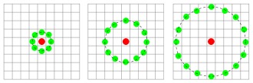
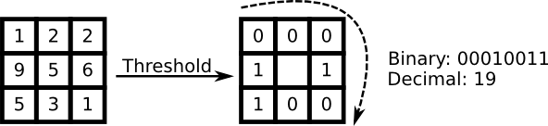
Face Recognition using LBPH Classifier
Local Binary patterns(LBP) Are a type of visual descriptor used for classification in computer vision .
LBP feature vector in its simplest form is created in the following manner
Divide the examined window into cells (e.g. 16x16 pixels for each cell).
For each pixel in a cell, compare the pixel to each of its 8 neighbors (on its left-top, left-middle, left-bottom, right-top, etc.). Follow the pixels along a circle, i.e. clockwise or counter-clockwise.
Where the center pixel's value is greater than the neighbor's value, write "0". Otherwise, write "1". This gives an 8-digit binary number (which is usually converted to decimal for convenience).
Compute the histogram, over the cell, of the frequency of each "number" occurring (i.e., each combination of which pixels are smaller and which are greater than the center). This histogram can be seen as a 256-dimensional feature vector.
Optionally normalize the histogram.
Concatenate (normalized) histograms of all cells. This gives a feature vector for the entire window

Slide 27
COMMUNICATION MODULE
Objective :
To develop an interactive android application which could be able to communicate with Inarmjha operating system
Inarmjha os will in turn communicate with all user specified smart devices to operate them and gives a feedback message to the end user
App should be able receive notifications from the user when connected over same network, even when it is unused and provide do not disturb mode to the user.

Slide 28
INARMJHA APP FLOW DIAGRAM
Sends notification to background service → json object
INARMJHA OS
MyService
Intent object
ViewImage
Background service is started using button
bitmap object
Listens to the os
Reply to os
Using intent
MainActivity
to communicate with os
TcpCommunication
Using intent object
Sends user message to os as json object
Scan devices over network using
WifiServiceDiscoveryActivity

Slide 29
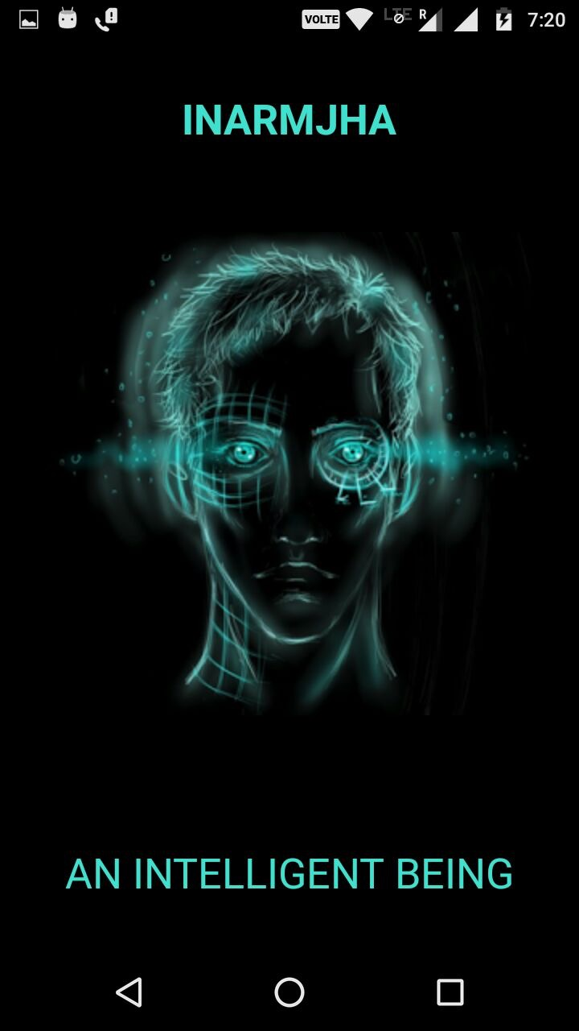
INARMJHA ANDROID APPLICATION
Introduction :
As usage of android apps is increasing drastically, Inarmjha app is used as a medium of communication between end user and Inarmjha os which in turn communicates with user specified smart devices in any home or office.
Requirements : Android mobile with API level higher than 19 or Kitkat (4.4) version
Target Audience 87.4%

Slide 30
Functionalities :
Start
Start receiving notifications from Inarmjha
Stop
Stop receiving notifications
(DO NOT DISTURB MODE)
Send
Send message to Inarmjha and set required Server IP and port number
Scan
Scan and list all connected devices over that network

Slide 31
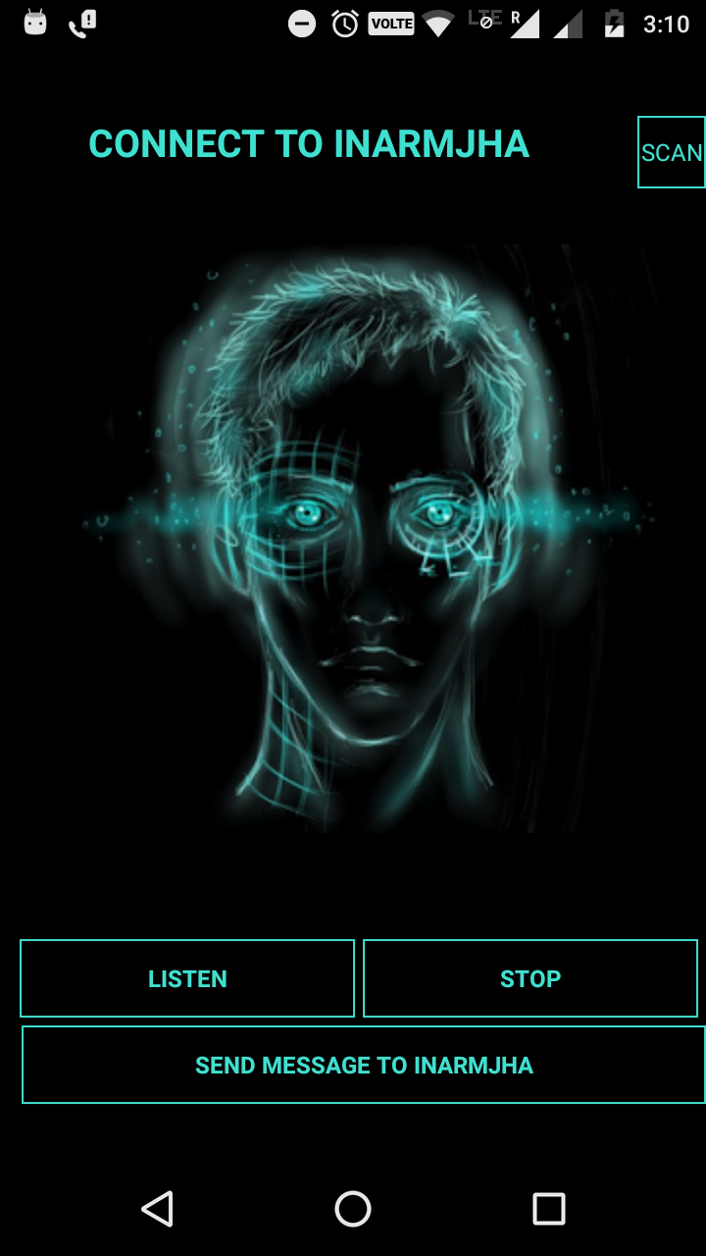
Start and stop receiving notifications:
MainActivity
Android provides services which run in background which do assigned work on background thread instead of main thread.
Inarmjha app uses a service which is enabled by pressing “LISTEN” button and it starts listening to Inarmjha os and gives user a notification whenever it receives a message from user.
This can be disabled by the user by pressing “STOP” button which kills the background service

Slide 32
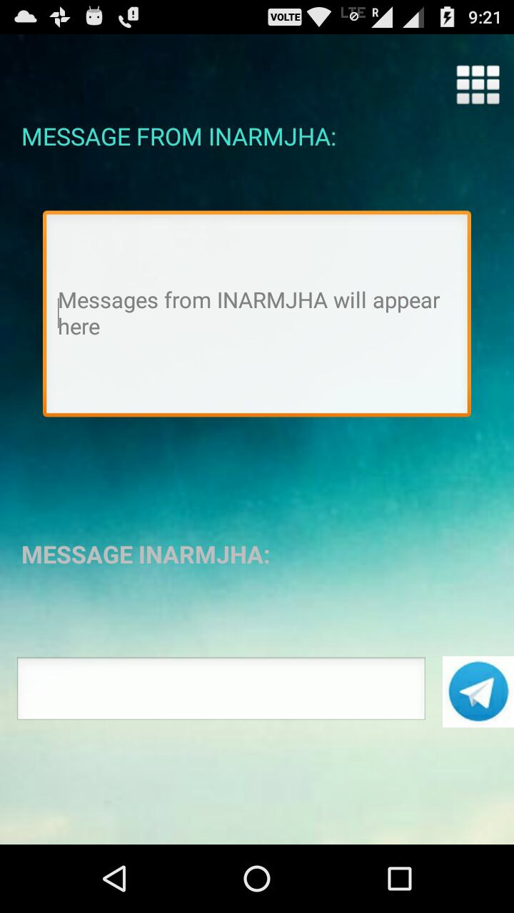
Message Inarmjha:
TcpCommunication
App uses java sockets to communicate with the os because it causes low network traffic.
Socket connection is established, then communication is initiated.
Message from server is displayed on the screen and the user can reply to it.

Slide 33
Inarmjha Address:
User connects to Inarmjha os using its IP address and port number.
Users may have to control one or more os (for example one at home and other at office)
Inarmjha app provides this feature to the user to connect to required os by knowing it’s IP address and port number.
User can connect and disconnect to the required os by entering it’s IP address and port number

Slide 34
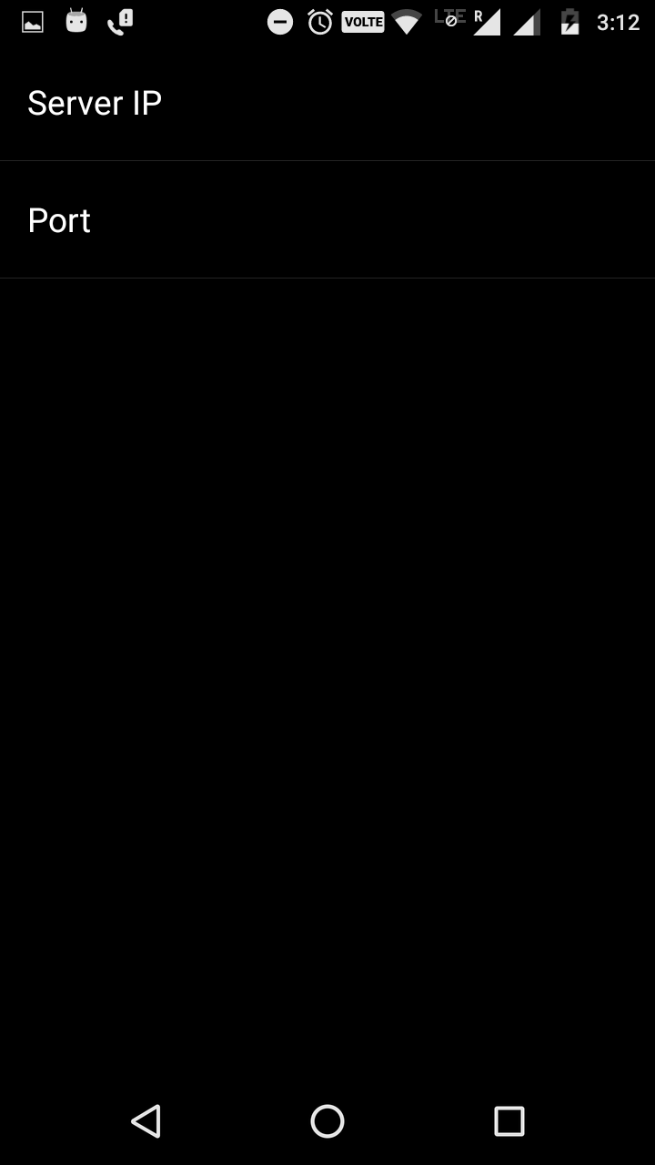
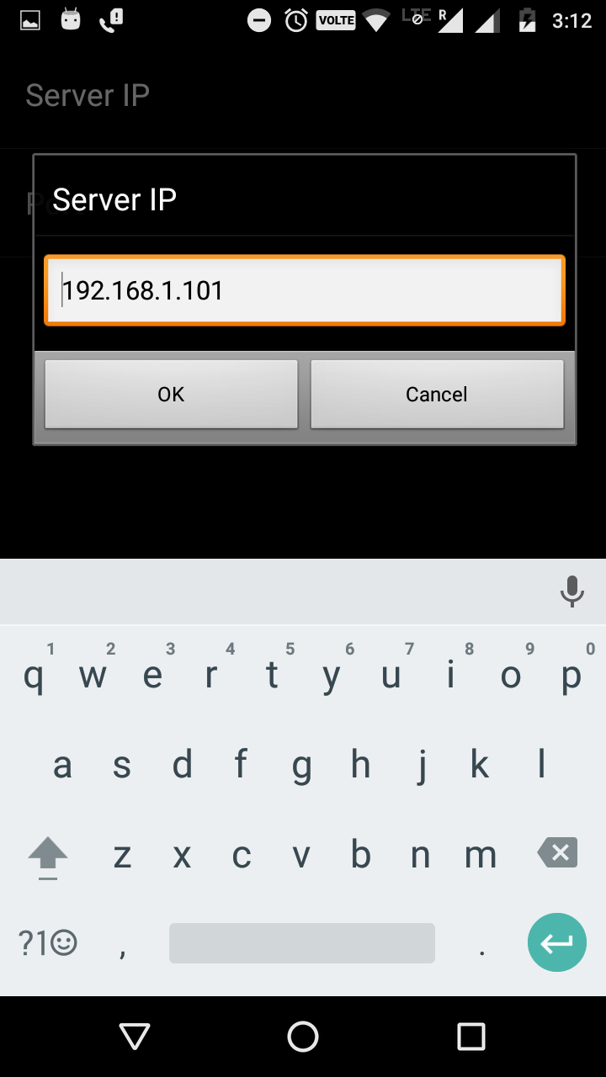
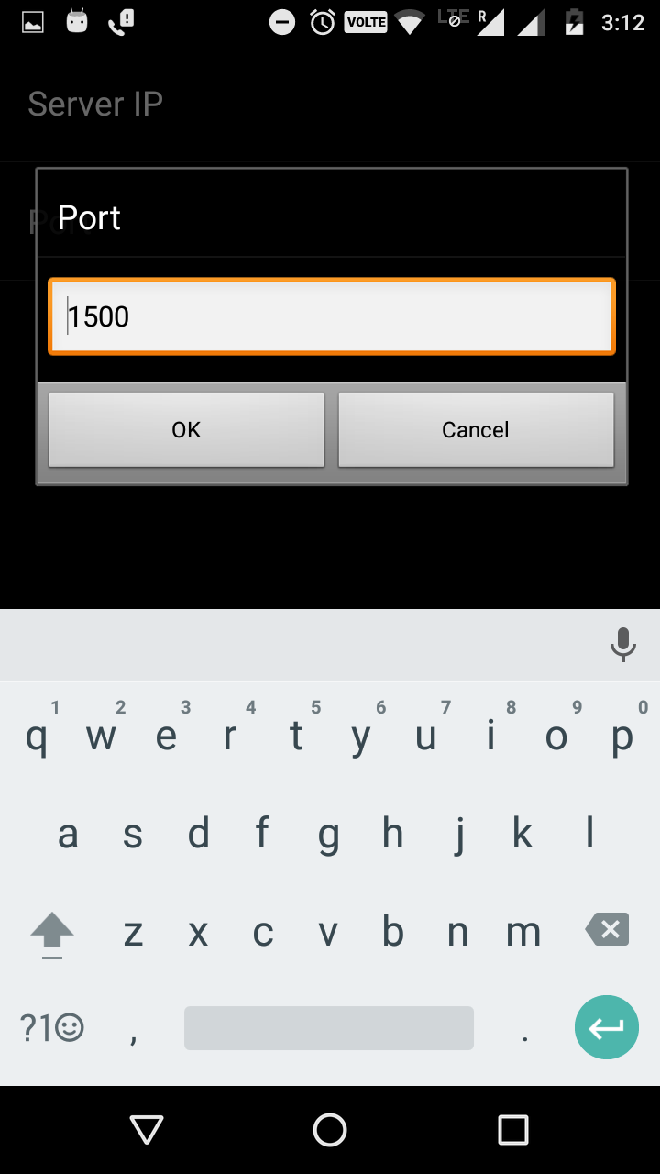
Change Inarmjha port number
SettingsActivity
Change Inarmjha IP

Slide 35
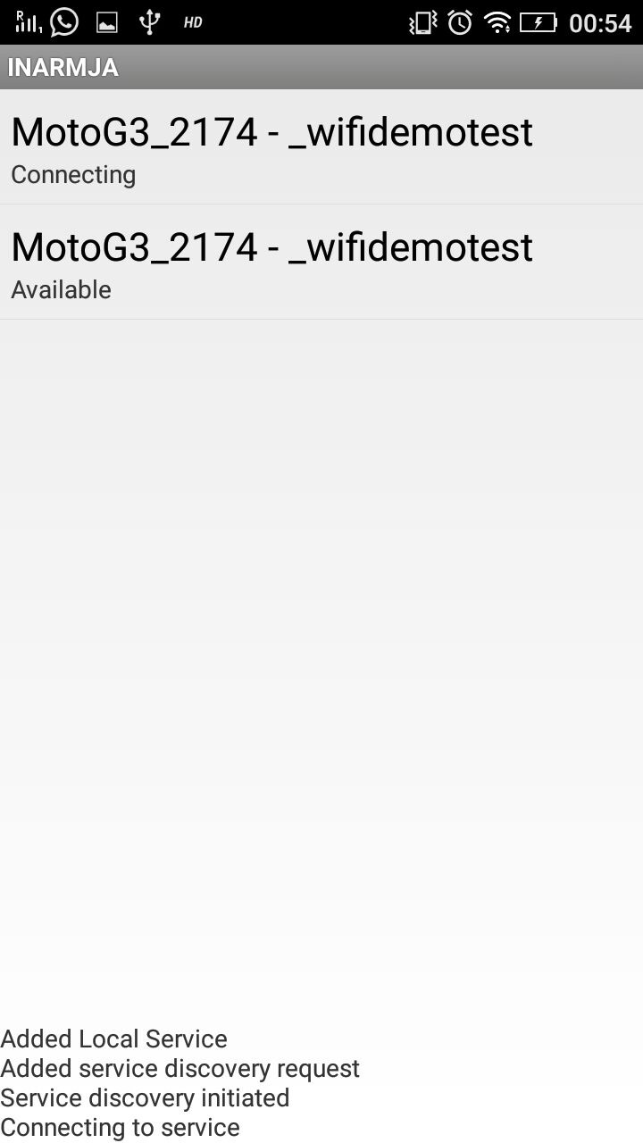
Scan devices over network:
WiFiServiceDiscoveryActivity
Wi-Fi peer-to-peer (P2P) allows devices with the appropriate hardware to connect directly to each other via Wi-Fi without an intermediate access point
Using this Api, we scan all the devices over the network and list out them.
This allows user to connect to the required device by communicating through the os.

Slide 36
Receiving Notifications:
App runs a background service that keeps listening to the os.
Whenever the os sends a message, it shoes it in the form af a notification in the notification bar
User can view the notification by clicking on it. It opens up an activity where he can send a message to the server or just ignore it.
Pressing ignore button closes the app but background service keeps on running

Slide 37
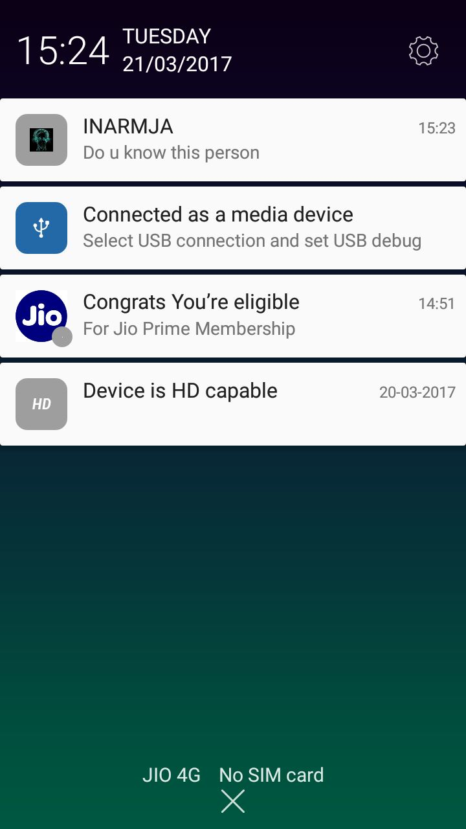
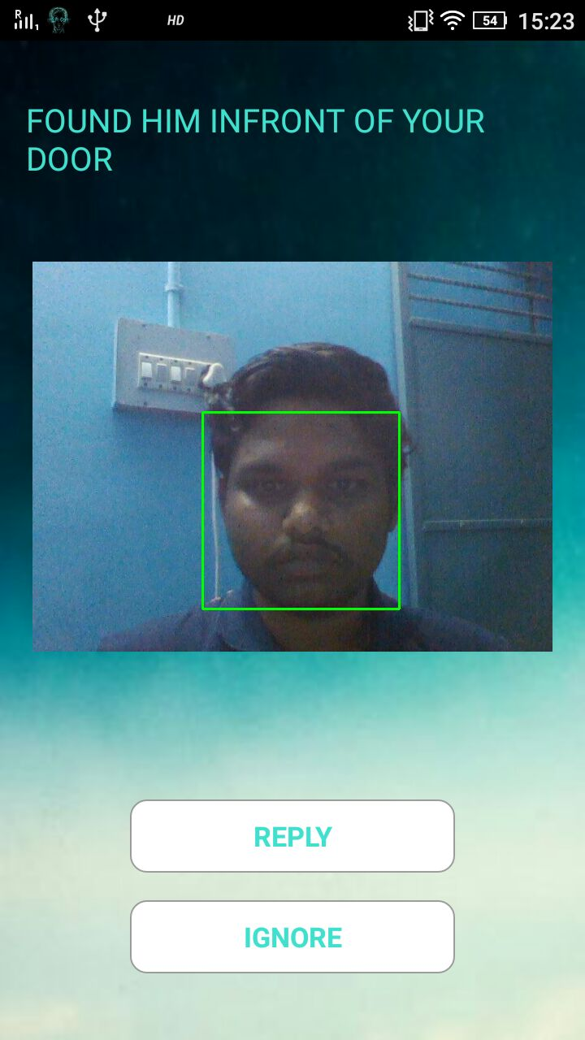
Notification Bar
View Image
Tcp Communication

Slide 38
DEVICE MODULE
Making devices run over Network

Slide 39
1. Controlling devices using Arduino
2. Establishing Communication between JHA and device.
3. Working of the latch door system.

Slide 40
Making devices RUN Over Network:
Using an Arduino uno(Microcontroller), We can control the devices .
Arduino Ethernet shield helps us to connect devices run over the network.
With the help of the IP of the device, the device module identifies the device and communicates with the device and completes the job assigned on that device.

Slide 41
Working of the device
The working prototype demonstrates the latch to lock the door.
A spiral shaft is used to embed axial motion of the latch through the rotatory motion of the motor using bolt and nut principle.
When the motor moves in the clockwise direction, it provides the latch a forward motion through the nut fixed on the shaft.
The voltage required for the motor is given through the relay circuit and a n-p-n transistor which makes the low voltage from the pins of Arduino into a required voltage.

Slide 42
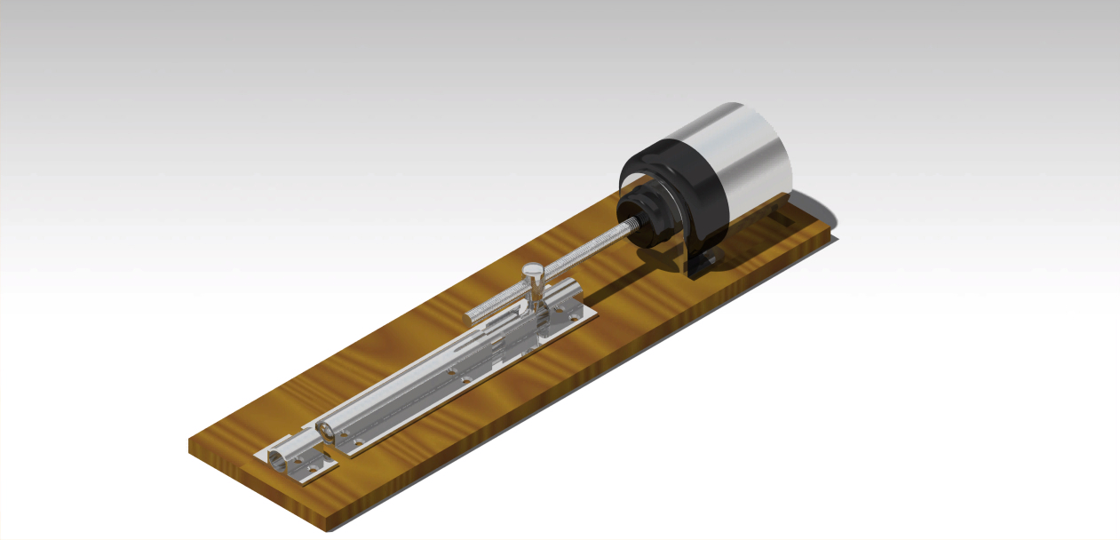
This Catia Diagram provides an isometric view of the latch designed, Which runs by bolt and nut principle as mentioned above.

Slide 43
FUTURE work
Communication between Arduino board and the Operating System.
1
Natural Language Processing Module.
2

